Slide 1
Evercreek Company Case Study
Richard Pham, Jefferson Ly, Andrew Feng Team 2

Slide 2


Project Description
Purpose:
Keep record of their employees
Keep record of product sales.
Keep track of the company performance, which is split into branches.
Use provided information to make changes that would produce more profit for the company.

Slide 3
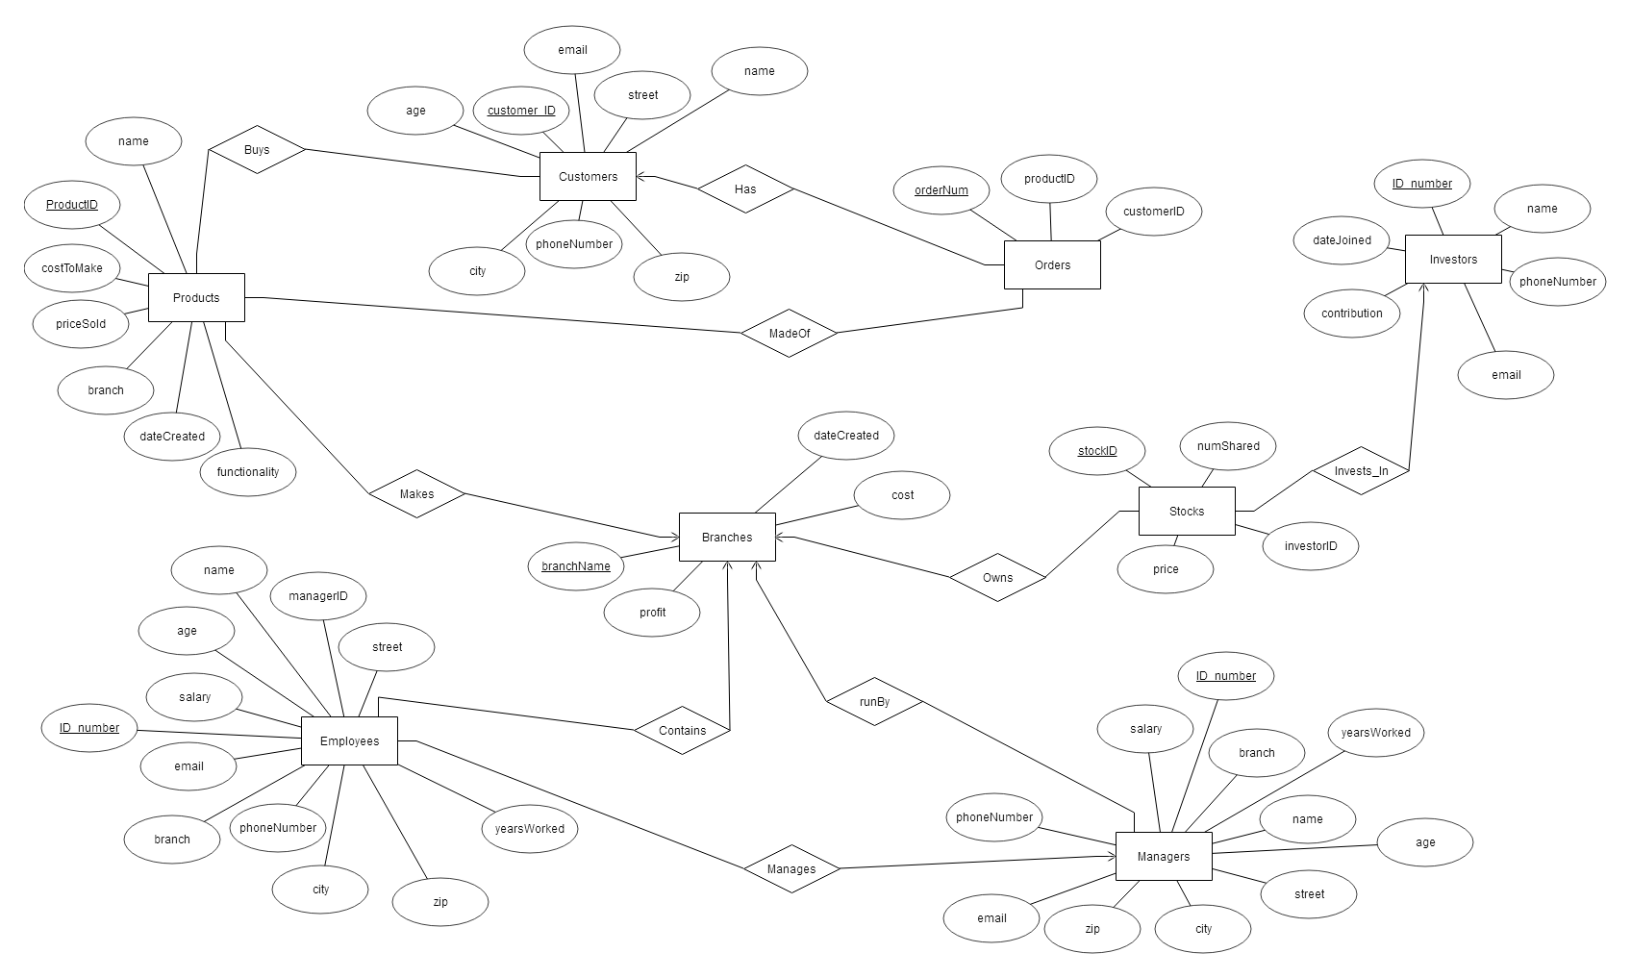
Original ER Design

Slide 4
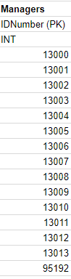
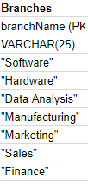
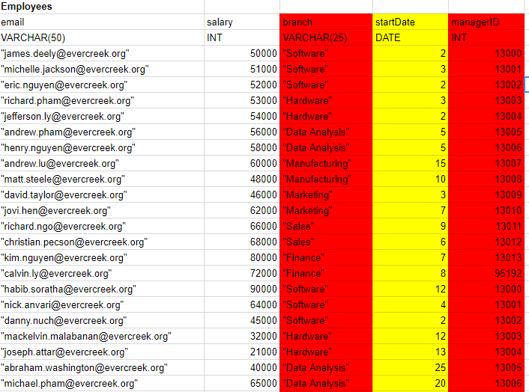
Original ER Design Flaws
Data redundancy
Some attributes should be split (example: name)
Years worked used instead of date; must be updated each year

Slide 5
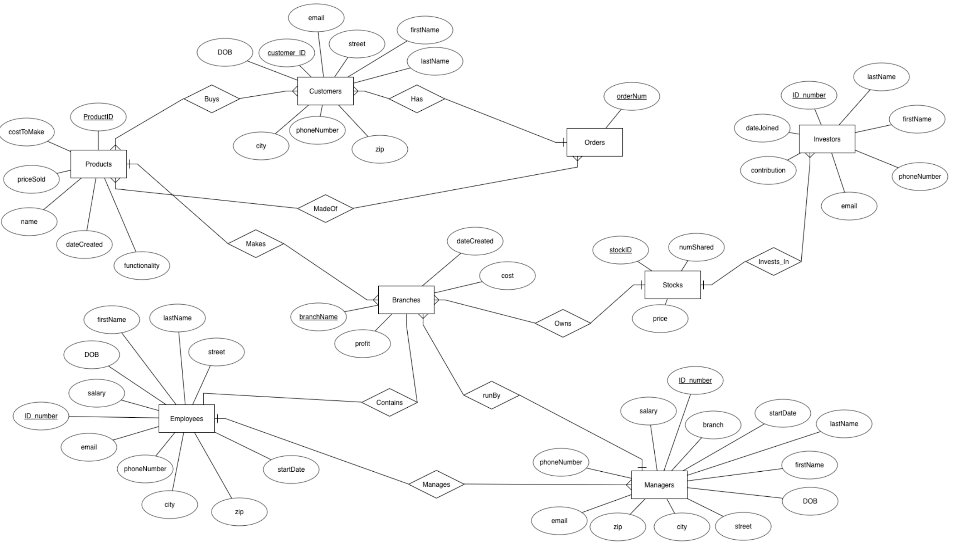
New ER Design

Slide 6
Project Triggers
Proposed but not implemented in project
Could be used to record company history
List of newly hired employees, fired employees
Discontinued products
Etc.
Not done since specific queries are better suited for these triggers than what is covered
We don’t have data modification queries

Slide 7
Project Triggers (cont,)
Example:
CREATE or replace TRIGGER insertIntoEmployeeHistory
BEFORE INSERT ON Employees
REFERENCING NEW AS newEmployee
FOR EACH ROW
BEGIN
INSERT INTO employeeHistory_table(action, IDNumber) VALUES('Hiring', :newEmployee.IDNumber);
END;

Slide 8
Relation Tables
Example: CREATE TABLE Buys(
customerID INT,
productID INT,
PRIMARY KEY(customerID, productID)
);

Slide 9
Project Views
Example: CREATE VIEW branchNames AS
SELECT branchName
FROM Branches;

Slide 10
Project Constraints
Example: CREATE TABLE Managers(
IDNumber INT PRIMARY KEY,
firstName VARCHAR(50) NOT NULL,
lastName VARCHAR(50) NOT NULL,
DOB DATE NOT NULL,
street VARCHAR(25) NOT NULL,
city VARCHAR(25) NOT NULL,
zip INT NOT NULL,
phoneNumber VARCHAR(25) NOT NULL,
email VARCHAR(50) NOT NULL,
salary INT NOT NULL,
branch VARCHAR(25) NOT NULL,
startDate DATE NOT NULL
);

Slide 11
Project Indexes
Example: CREATE INDEX EmpManInd ON Manages(employeeID);
Helpful for getting manager that employees work for

Slide 12


Implementation
MySQL Workbench 8.0 CE
Java, Eclipse Photon, JDBC

Slide 13
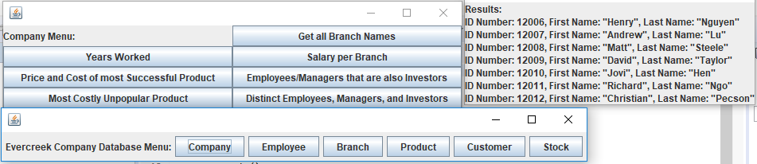
Project Demo

